Slide 1
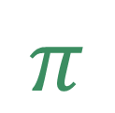
Chapter 4: Multivariate Normal Distribution
Applied Multivariate Statistical Analysis
6th edition by Johnson & Wichern
$$π$$
Gabrielle Salamanca

Slide 2

Overview
$$π$$
Objectives
4.6: Assessing the Assumption of Normality
Evaluating the Normality of the Univariate Marginal Distributions
Evaluating Bivariate Normality
4.7: Detecting Outliers & Cleaning Data
4.8: Transformations to Near Normality

Slide 3

Objectives
$$π$$
Ch 4.6
How to evaluate normality
Visually
Mathematically
Ch 4.7
How to detect outliers
Visually
Mathematically
Ch 4.8
Understand why we would transform the data
How to transform the data

Slide 4
Assessing the Assumption of Normality
1
Chapter 4, Section 6

Slide 5

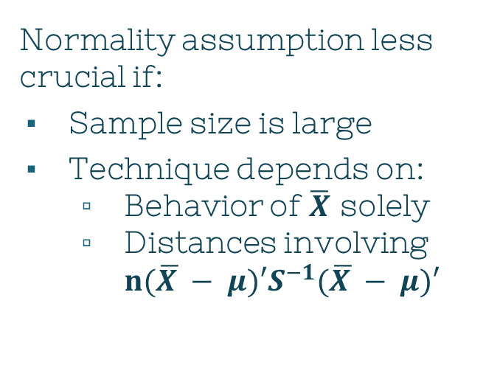
Normality & Techniques
$$π$$
Most techniques assume
Each $\vec{X_{j}}\sim 𝓝(μ,Σ)$
Normality assumption less crucial if:
Sample size is large
Technique depends on:
Behavior of $\overline{X}$ solely
Distances involving $n(\overline{X }− μ)′S^{−1}(\overline{X }− μ)′$
Notes:
In previous chapters, most of the statistical techniques discussed in previous chapters assume that each vector observation Xj comes from a MVN distr. However, that normality assumption isn’t as important if the sample size is large and the techniques solely depend on Xbar matrix’s behavior or distances involving that matrix of the form n(Xbar - mu)’S-1(Xbar – mu)

Slide 6
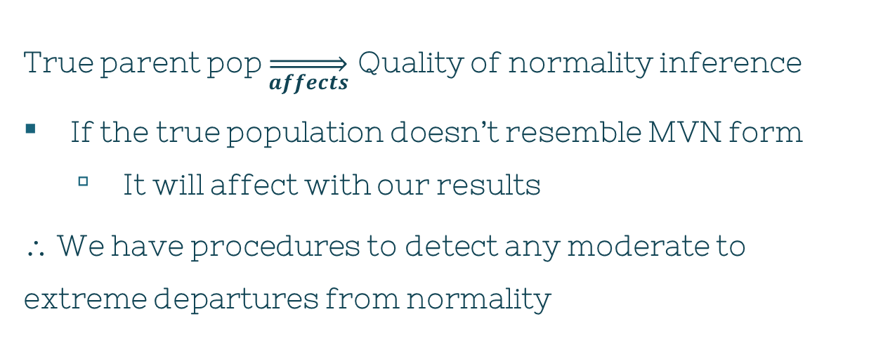
Normality & Techniques
$$π$$
True parent pop $\overset{⇒}{affects}$ Quality of normality inference
If the true population doesn’t resemble MVN form
It will affect with our results
∴ We have procedures to detect any moderate to extreme departures from normality

Slide 7
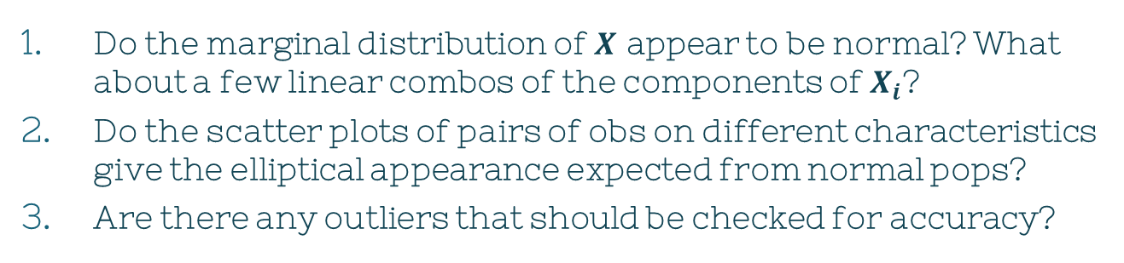
Normality Questions
$$π$$
Do the observations $\vec{X_{j}}$ appear to violate the normality assumption?
Do the marginal distribution of $X$ appear to be normal? What about a few linear combos of the components of $X_{i}$?
Do the scatter plots of pairs of obs on different characteristics give the elliptical appearance expected from normal pops?
Are there any outliers that should be checked for accuracy?

Slide 8
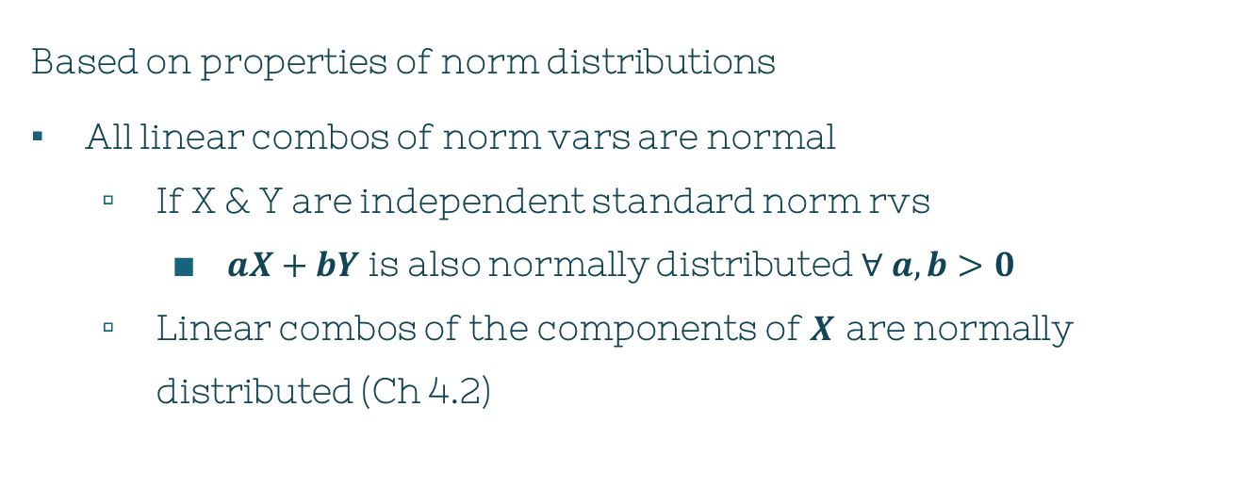
Normality Questions
$$π$$
Based on properties of norm distributions
All linear combos of norm vars are normal
If X & Y are independent standard norm rvs
$aX+bY$ is also normally distributed $∀ a,b>0$
Linear combos of the components of $X$ are normally distributed (Ch 4.2)

Slide 9
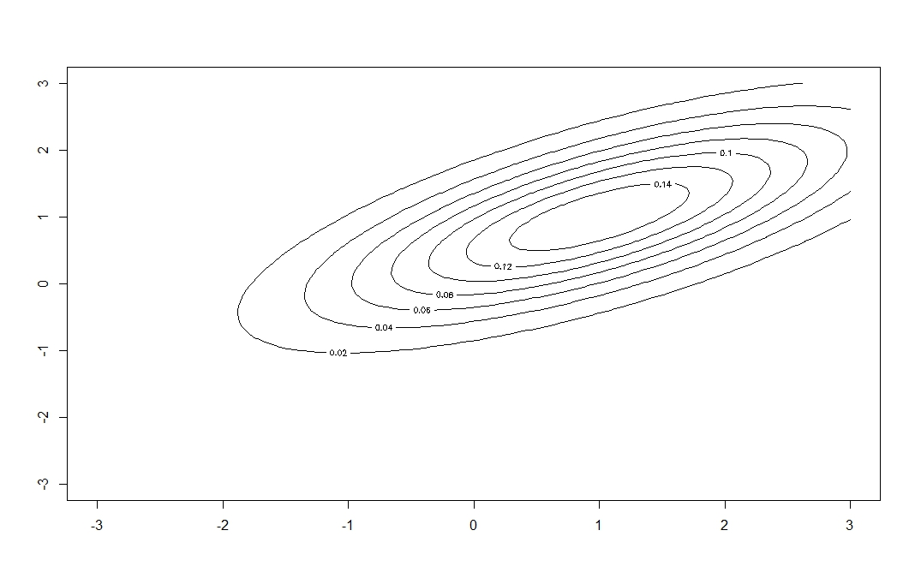
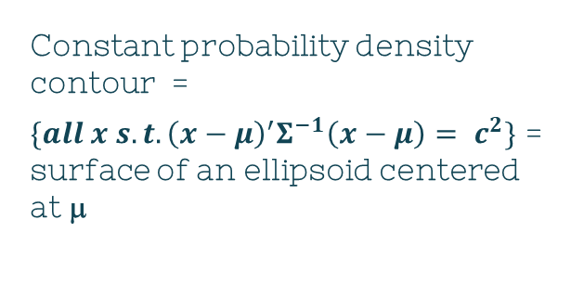
Normality Questions
$$π$$
Based on properties of norm distributions
Contours of MVN density are ellipsoids (Ch 4.2)
Constant probability density contour =
$\{all x s.t. {\left(x−μ\right)}^{′}Σ^{−1}\left(x−μ\right)= c^{2}\}$ = surface of an ellipsoid centered at μ

Slide 10
Heads Up
Investigations of normality
Mainly concentrating in 1D or 2D
Consequence:
Can’t guarantee we’ll catch every little feature that’s revealed only in higher dimensions

Slide 11
Univariate Evaluation
$$π$$
1. Visually
Dot diagrams
Histograms
Q-Q plots
2. Mathematically
Area under the curve of a normal distribution

Slide 12
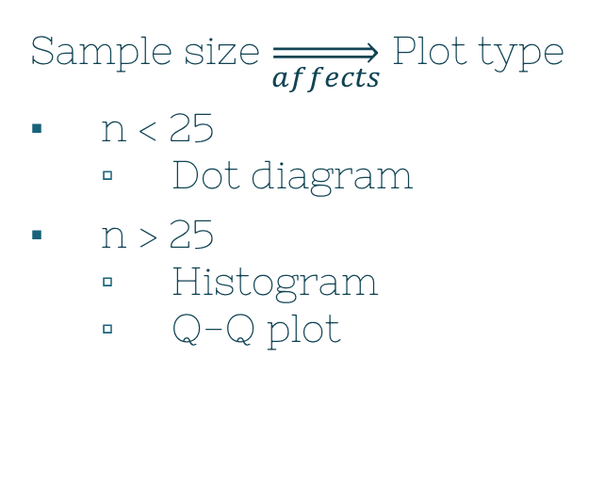
Univariate Evaluation
$$π$$
Sample size $\overset{⇒}{affects}$ Plot type
n < 25
Dot diagram
n > 25
Histogram
Q-Q plot
Check if the distribution is skewed
If it appears symmetric
then calculations are in order

Slide 13
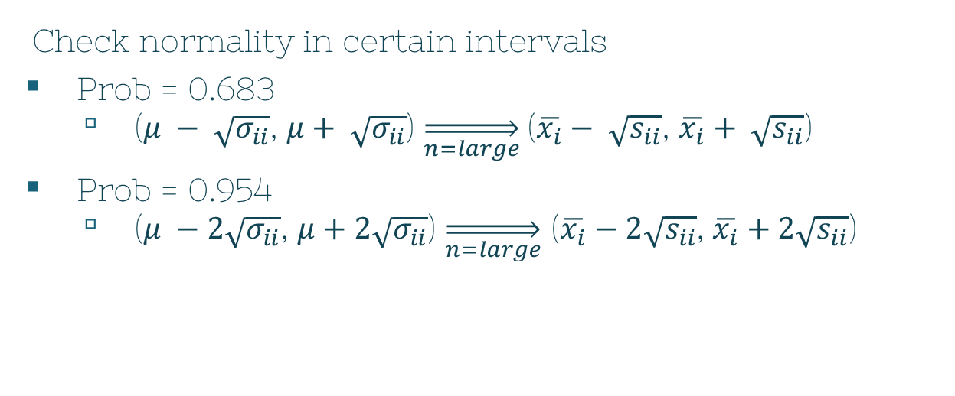
Univariate Evaluation
$$π$$
Check normality in certain intervals
Prob = 0.683
($μ − \sqrt{σ_{ii}}$, $μ+ \sqrt{σ_{ii}}$) $\overset{⇒}{n=large}$($\overline{x_{i}}− \sqrt{s_{ii}}$, $\overline{x_{i}}+ \sqrt{s_{ii}}$)
Prob = 0.954
($μ −2\sqrt{σ_{ii}}$, $μ+2\sqrt{σ_{ii}}$) $\overset{⇒}{n=large}$ ($\overline{x_{i}}−2\sqrt{s_{ii}}$, $\overline{x_{i}}+2\sqrt{s_{ii}}$)

Slide 14
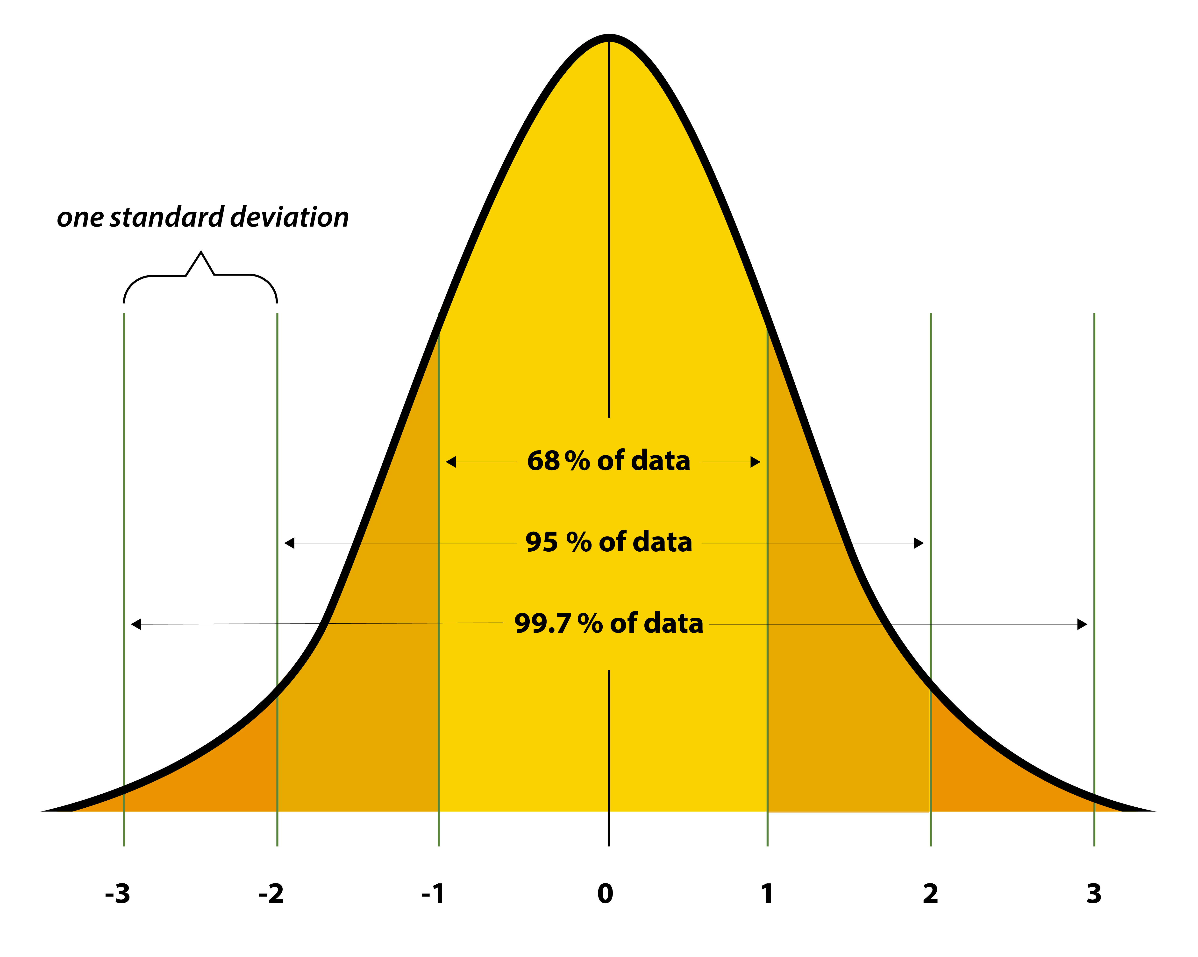
Image: Standard normal distribution curve." Sampling Distributions for Counts and Proportions.
University of North Carolina, Freeman and Company. 2009.

Slide 15
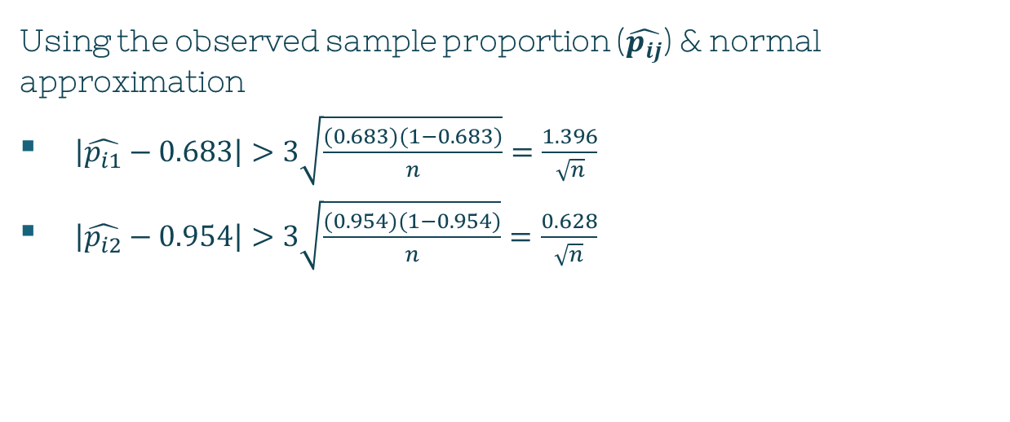
Univariate Evaluation
$$π$$
Using the observed sample proportion ($\hat{p_{ij}}$) & normal approximation
$\left|\hat{p_{i1}}−0.683\right|>3\sqrt{\frac{(0.683)(1−0.683)}{n}}=\frac{1.396}{\sqrt{n}}$
$\left|\hat{p_{i2}}−0.954\right|>3\sqrt{\frac{(0.954)(1−0.954)}{n}}=\frac{0.628}{\sqrt{n}}$
Notes:
We expect the observed proportion p-hat of observations lying on the interval to be about 0.683/0.954
If the observed props are too small, the parent distr with thicker tails than normal are suggested

Slide 16
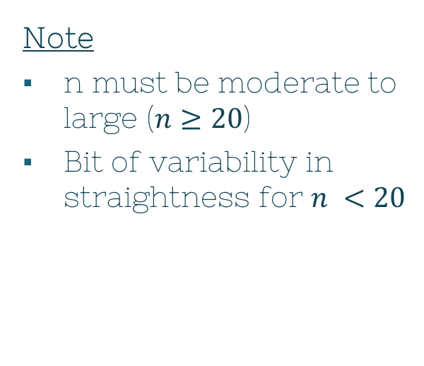
Univariate Evaluation: QQ plot
$$π$$
Q-Q (quantile-quantile) plot
Another way to assess if the obs came from MVN
Two sets of quantiles/percentiles of the data plotted on a scatter plot
If it forms a roughly straight line
⇒ normality assumption holds
Note
n must be moderate to large ($n≥20$)
Bit of variability in straightness for $n <20$
Notes:
We expect the observed proportion p-hat of observations lying on the interval to be about 0.683/0.954
If the observed props are too small, the parent distr with thicker tails than normal are suiggested

Slide 17
Univariate Evaluation: QQ plot
$$π$$
Q-Q (quantile-quantile) plot
Can also provide clues about the nature of non-normality
Pattern of deviations
There are ways to handle non-normal data
More in Ch 4.8!
Notes:
We expect the observed proportion p-hat of observations lying on the interval to be about 0.683/0.954
If the observed props are too small, the parent distr with thicker tails than normal are suiggested

Slide 18
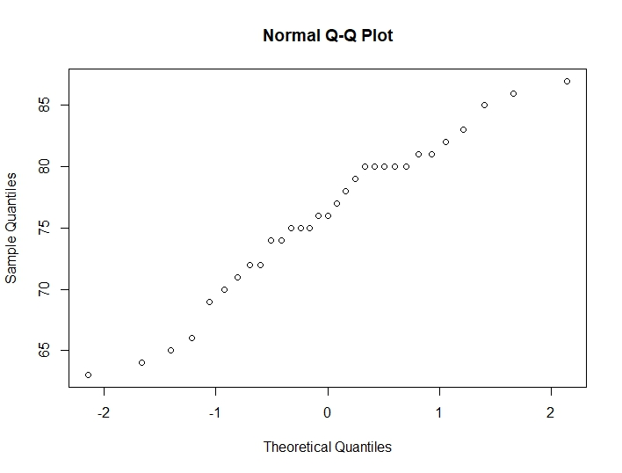
Univariate Evaluation: QQ plot
$$π$$
Q-Q (quantile-quantile) plot
trees dataset in R
31 observations
3 columns
qqnorm(trees$Height)
Relatively straight
Notes:
We expect the observed proportion p-hat of observations lying on the interval to be about 0.683/0.954
If the observed props are too small, the parent distr with thicker tails than normal are suiggested

Slide 19
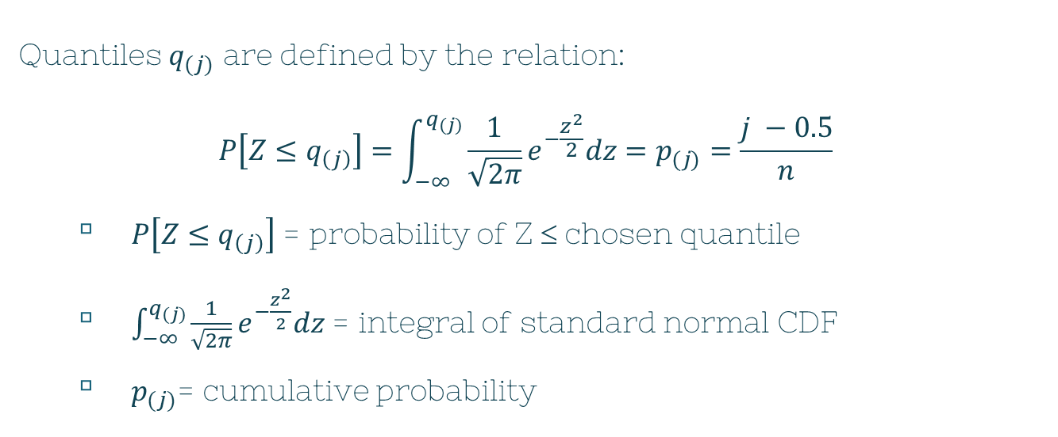
Univariate Evaluation: Histogram
$$π$$
Quantiles $q_{(j)}$ are defined by the relation:
$$P\left[Z≤q_{\left(j\right)}\right]=\int_{−∞}^{q_{(j)}}{\frac{1}{\sqrt{2π}}e^{−\frac{z^{2}}{2}}dz=p_{(j)}=\frac{j −0.5}{n}}$$
$P\left[Z≤q_{\left(j\right)}\right]$ = probability of Z ≤ chosen quantile
$\int_{−∞}^{q_{(j)}}{\frac{1}{\sqrt{2π}}e^{−\frac{z^{2}}{2}}dz}$ = integral of standard normal CDF
$p_{(j)}$= cumulative probability
Notes:
Let xn’s be n observations on any single characteristic Xi
Let x-sub-n’s be observations after they’re ordered according to magnitude
X-sub1 is smallest observation, while x-subn is the largest

Slide 20
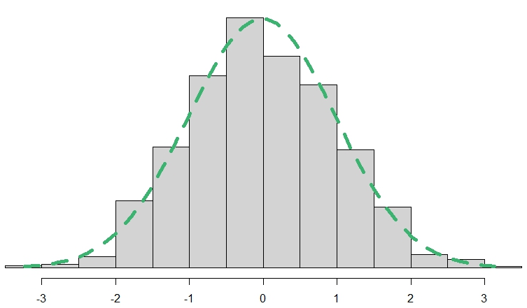
Visual Aid: Histogram

Slide 21


Univariate Evaluation: Histogram
$$π$$
$x_{1},x_{2},…,x_{n}$
n obs on any characteristic $X_{i}$
$x_{(j)}$
Sample quantile
Quantile from your data
Look at $(q_{\left(j\right)},x_{(j)})$ with the same $p_{(j)}$
Linearly related = normal
Notes:
Distinct = theoretically always true when obs are cont
Prop = analytical convenience -> continuity correction

Slide 22
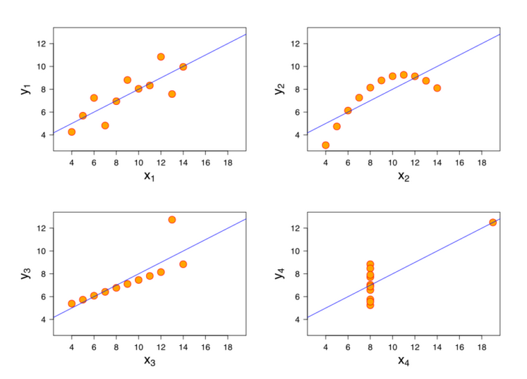
Screenshot from:
https://courses.lumenlearning.com/wm-concepts-statistics/chapter/introduction-linear-relationships/

Slide 23

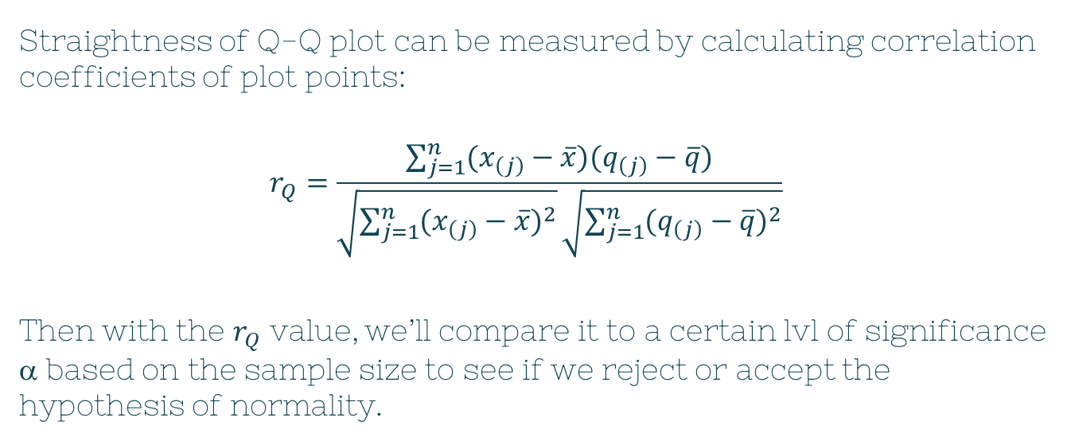
Univariate Evaluation: $r_{Q}$
$$π$$
Straightness of Q-Q plot can be measured by calculating correlation coefficients of plot points:
$$r_{Q}=\frac{\sum_{j=1}^{n}{(x_{\left(j\right)}−\overline{x})(q_{\left(j\right)}−\overline{q})}}{\sqrt{\sum_{j=1}^{n}{{(x_{\left(j\right)}−\overline{x})}^{2}}}\sqrt{\sum_{j=1}^{n}{{(q_{\left(j\right)}−\overline{q})}^{2}}}}$$
Then with the $r_{Q}$ value, we’ll compare it to a certain lvl of significance α based on the sample size to see if we reject or accept the hypothesis of normality.
Notes:
We expect the observed proportion p-hat of observations lying on the interval to be about 0.683/0.954
If the observed props are too small, the parent distr with thicker tails than normal are suiggested

Slide 24
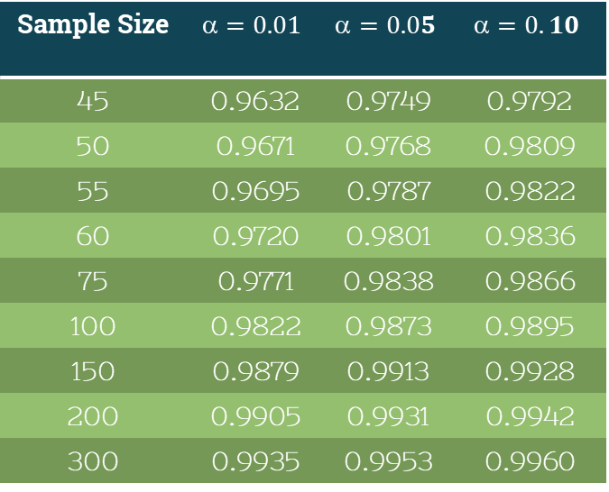
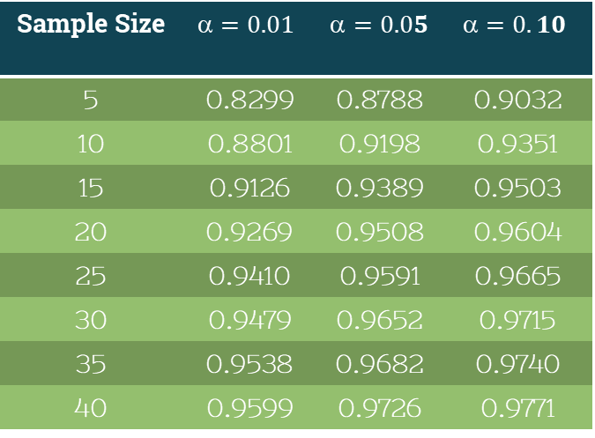
$$π$$
Sample Size | $$=0.01$$ | $$=0.05$$ | $$=0.10$$
5 | 0.8299 | 0.8788 | 0.9032
10 | 0.8801 | 0.9198 | 0.9351
15 | 0.9126 | 0.9389 | 0.9503
20 | 0.9269 | 0.9508 | 0.9604
25 | 0.9410 | 0.9591 | 0.9665
30 | 0.9479 | 0.9652 | 0.9715
35 | 0.9538 | 0.9682 | 0.9740
40 | 0.9599 | 0.9726 | 0.9771
Sample Size | $$=0.01$$ | $$=0.05$$ | $$=0.10$$
45 | 0.9632 | 0.9749 | 0.9792
50 | 0.9671 | 0.9768 | 0.9809
55 | 0.9695 | 0.9787 | 0.9822
60 | 0.9720 | 0.9801 | 0.9836
75 | 0.9771 | 0.9838 | 0.9866
100 | 0.9822 | 0.9873 | 0.9895
150 | 0.9879 | 0.9913 | 0.9928
200 | 0.9905 | 0.9931 | 0.9942
300 | 0.9935 | 0.9953 | 0.9960
Table 4.2: Critical Points for Q-Q Plot $r_{Q}$ Test for Normality
Notes:
We expect the observed proportion p-hat of observations lying on the interval to be about 0.683/0.954
If the observed props are too small, the parent distr with thicker tails than normal are suiggested

Slide 25
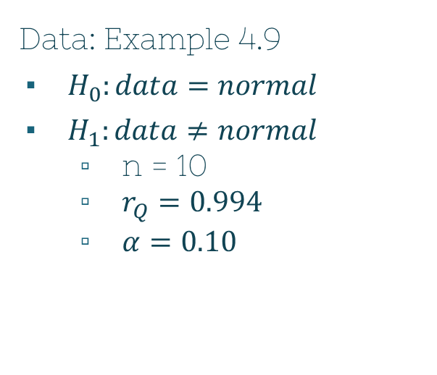

Univariate Evaluation: Example 4.11
$$π$$
Data: Example 4.9
$H_{0}:data=normal$
$H_{1}:data≠normal$
n = 10
$r_{Q}=0.994$
$α=0.10$
When n = 10 at $α=0.10$
$r=\text{0.9351}$
$r_{Q}=0.994$ > $\text{0.9351}\text{ =} r$
$H_{0}$ not rejected
Notes:
We expect the observed proportion p-hat of observations lying on the interval to be about 0.683/0.954
If the observed props are too small, the parent distr with thicker tails than normal are suiggested

Slide 26

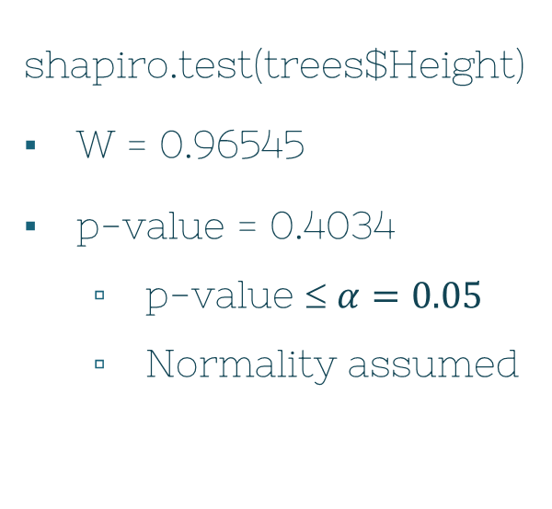
Univariate Evaluation: $r_{Q}$
$$π$$
Shapiro & Wilk normality test
Hypothesis test that evaluates the normality of a dataset
Large p-value = normality
Small p-value = non-normal
shapiro.test(trees$Height)
W = 0.96545
p-value = 0.4034
p-value ≤ $α=0.05$
Normality assumed
Notes:
We expect the observed proportion p-hat of observations lying on the interval to be about 0.683/0.954
If the observed props are too small, the parent distr with thicker tails than normal are suiggested

Slide 27

Correlation Note
$$π$$
Book preference
$r_{Q}$
Corresponds directly to pts in normal-scores plot
For large sample sizes
Either is fine
The statistics are nearly the same
Notes:
We expect the observed proportion p-hat of observations lying on the interval to be about 0.683/0.954
If the observed props are too small, the parent distr with thicker tails than normal are suiggested

Slide 28
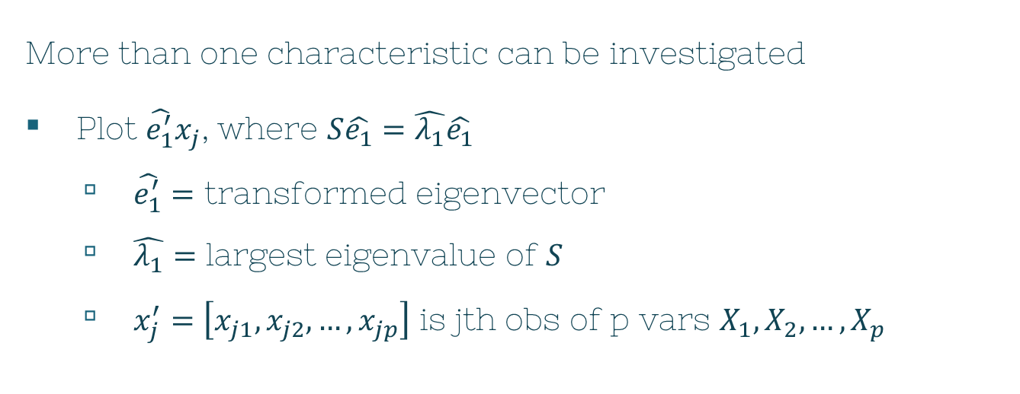
Linear Combos
$$π$$
More than one characteristic can be investigated
Plot $\hat{e_{1}^{′}}x_{j}$, where $S\hat{e_{1}}=\hat{λ_{1}}\hat{e_{1}}$
$\hat{e_{1}^{′}}=$ transformed eigenvector
$\hat{λ_{1}}=$ largest eigenvalue of $S$
$x_{j}^{′}=\left[x_{j1},x_{j2},…,x_{jp}\right]$ is jth obs of p vars $X_{1}, X_{2},…,X_{p}$

Slide 29
Bivariate Evaluation
$$π$$
Normality check
∀ distributions of 2, 3, …, p dims
Visually
Scatterplots for pairs of characteristics
MVN distr ~ elliptical

Slide 30
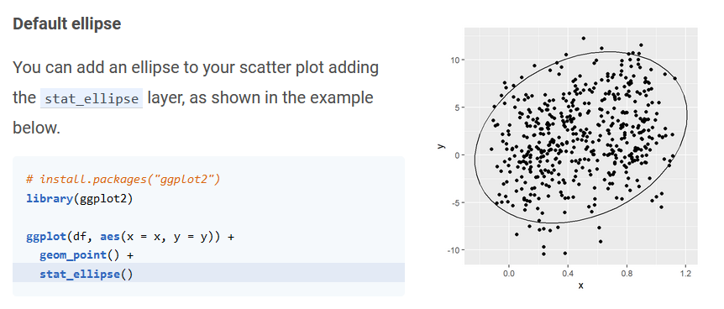
Screenshot from: https://r-charts.com/correlation/scatter-plot-ellipses-ggplot2/

Slide 31
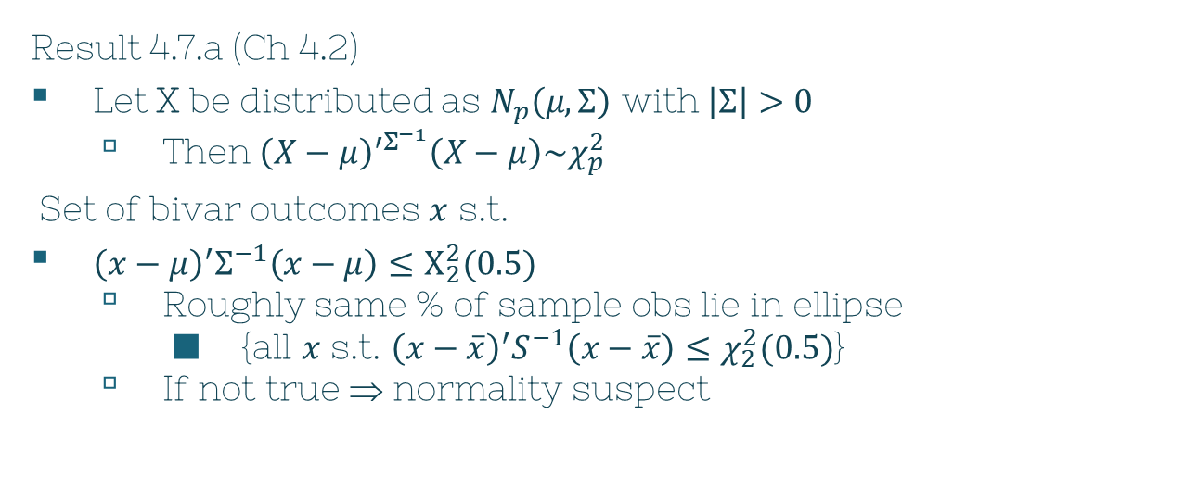

Bivariate Evaluation
$$π$$
Result 4.7.a (Ch 4.2)
Let X be distributed as $N_{p}\left(μ,Σ\right)$ with $\left|Σ\right|>0$
Then ${\left(X−μ\right)}^{′Σ^{−1}}\left(X−μ\right)\sim χ_{p}^{2}$
Set of bivar outcomes $x$ s.t.
${\left(x−μ\right)}^{′}Σ^{−1}\left(x−μ\right)≤Χ_{2}^{2}(0.5)$
Roughly same % of sample obs lie in ellipse
{all $x$ s.t. ${\left(x−\overline{x}\right)}^{′}S^{−1}\left(x−\overline{x}\right)≤χ_{2}^{2}(0.5)$}
If not true ⇒ normality suspect
$$↷$$

Slide 32
Company | Sales (billions) | Profits (billions) | Assets (billions)
Citigroup | 108.28 | 17.05 | 1484.10
General Electric | 152.36 | 16.59 | 750.33
American Intl Group | 95.04 | 10.91 | 766.42
Bank of America | 65.45 | 14.14 | 1110.46
HSBC Group | 62.97 | 9.52 | 1031.29
ExxonMobil | 263.99 | 25.33 | 195.26
Royal Dutch/Shell | 265.19 | 18.54 | 193.83
BP | 285.06 | 15.73 | 191.11
ING Group | 92.01 | 8.10 | 1175.16
Toyota Motor | 165.68 | 11.13 | 211.15
$$π$$
Example 4.12: The World’s 10 Largest Companies (Exercise 1.4)

Slide 33
Company | Sales (billions) | Profits (billions)
Citigroup | 108.28 | 17.05
General Electric | 152.36 | 16.59
American Intl Group | 95.04 | 10.91
Bank of America | 65.45 | 14.14
HSBC Group | 62.97 | 9.52
ExxonMobil | 263.99 | 25.33
Royal Dutch/Shell | 265.19 | 18.54
BP | 285.06 | 15.73
ING Group | 92.01 | 8.10
Toyota Motor | 165.68 | 11.13
$$π$$
Example 4.12: The World’s 10 Largest Companies

Slide 34
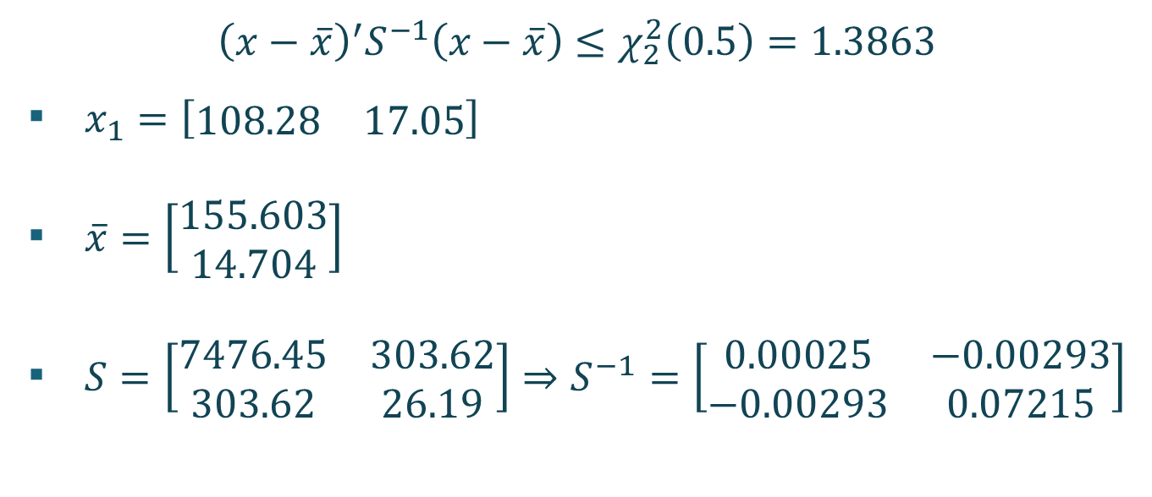
Example 4.12
$$π$$
$${\left(x−\overline{x}\right)}^{′}S^{−1}\left(x−\overline{x}\right)≤χ_{2}^{2}\left(0.5\right)=1.3863$$
$x_{1}=\left[\begin{matrix}108.28 & 17.05\end{matrix}\right]$
$\overline{x}=\left[\begin{matrix}155.603 \\ 14.704\end{matrix}\right]$
$S=\left[\begin{matrix}7476.45 & 303.62 \\ 303.62 & 26.19\end{matrix}\right]⇒S^{−1}=\left[\begin{matrix}0.00025 & −0.00293 \\ −0.00293 & 0.07215\end{matrix}\right]$

Slide 35
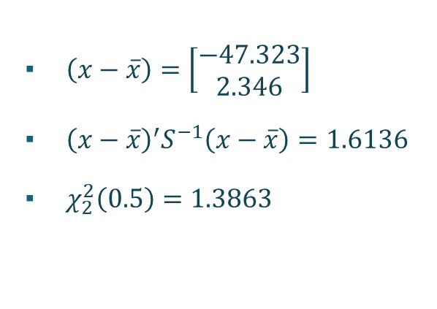


Example 4.12
$$π$$
$${\left(x−\overline{x}\right)}^{′}S^{−1}\left(x−\overline{x}\right)≤χ_{2}^{2}\left(0.5\right)$$
$\left(x−\overline{x}\right)=\left[\begin{matrix}−47.323 \\ 2.346\end{matrix}\right]$
${\left(x−\overline{x}\right)}^{′}S^{−1}\left(x−\overline{x}\right)=1.6136$
$χ_{2}^{2}\left(0.5\right)=1.3863$
$1.6136≤1.3863$
This observation is outside the 50% contour

Slide 36
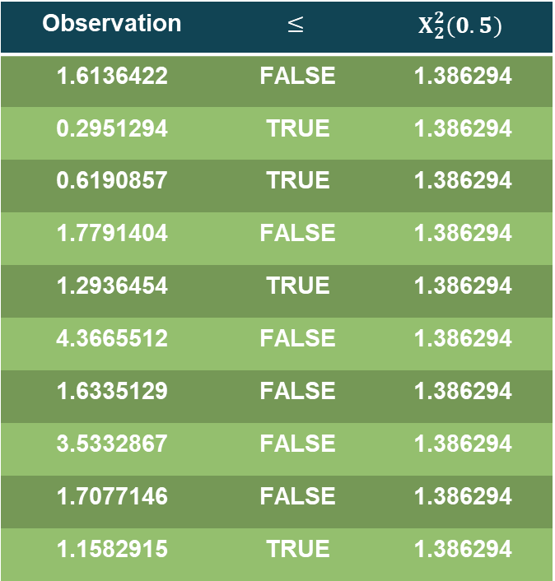
Example 4.12
Observation | $$≤$$ | $$Χ_{2}^{2}(0.5)$$
1.6136422 | FALSE | 1.386294
0.2951294 | TRUE | 1.386294
0.6190857 | TRUE | 1.386294
1.7791404 | FALSE | 1.386294
1.2936454 | TRUE | 1.386294
4.3665512 | FALSE | 1.386294
1.6335129 | FALSE | 1.386294
3.5332867 | FALSE | 1.386294
1.7077146 | FALSE | 1.386294
1.1582915 | TRUE | 1.386294
$$π$$
4/10 obs fall into 50% contour
Normality suspect
Disclaimer:
n = 10
Too small to reach conclusion

Slide 37
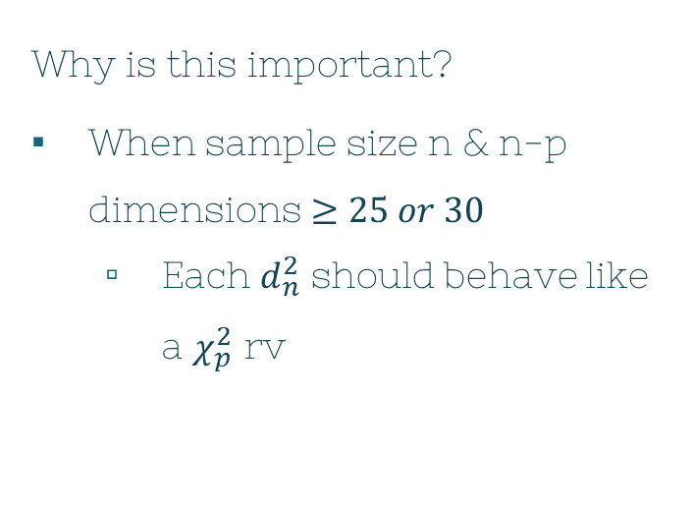

Bivariate Evaluation
$$π$$
Formal method:
$d_{j}^{2}={\left(x_{j}−\overline{x}\right)}^{′}S^{−1}\left(x_{j}−\overline{x}\right)$
j = 1, … , n
Can be used for $p≥2$
Why is this important?
When sample size n & n-p dimensions $≥25 or 30$
Each $d_{n}^{2}$ should behave like a $χ_{p}^{2}$ rv

Slide 38
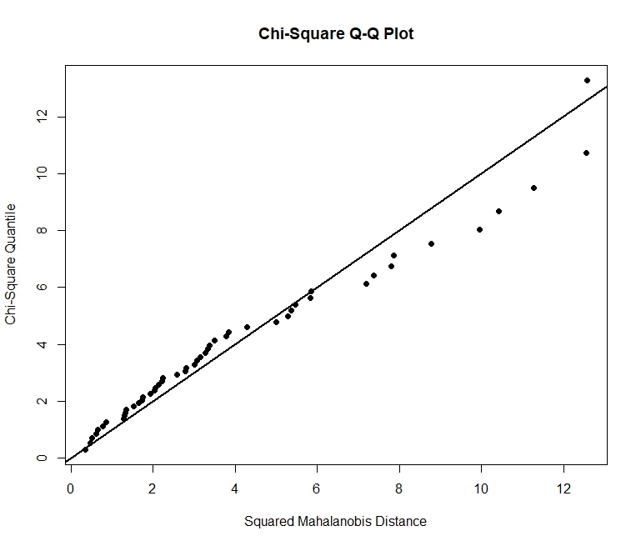
Bivariate Evaluation
$$π$$
library(MVN)
data(iris)
setosa <- iris[1:50, 1:4]
mvn(setosa,
multivariatePlot = "qq")

Slide 39
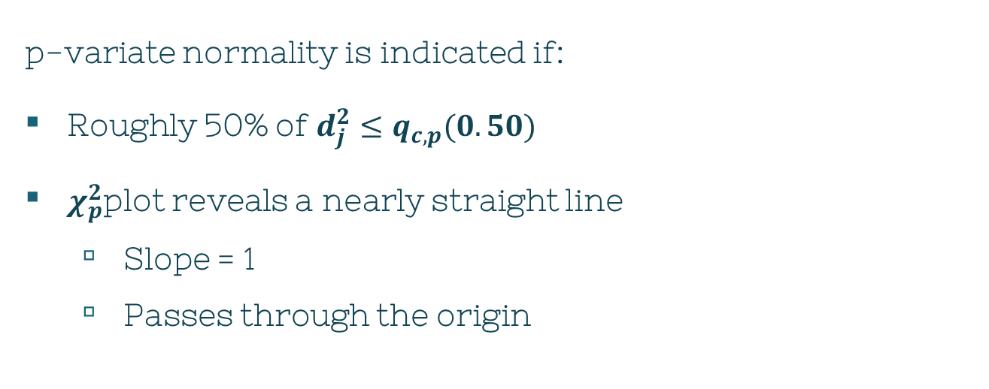
MVN Evaluation
$$π$$
p-variate normality is indicated if:
Roughly 50% of $d_{j}^{2}≤q_{c,p}(0.50)$
$χ_{p}^{2}$plot reveals a nearly straight line
Slope = 1
Passes through the origin

Slide 40
Detecting Outliers & Cleaning Data
2
Chapter 4, Section 7

Slide 41
Definition
Outlier
An unusual observation that differs from significantly from the others

Slide 42
Heads Up
Not all outliers are wrong numbers!
May justifiably be with the group
May lead to better understanding of the phenomena being studied

Slide 43
Outlier
$$π$$
Single characteristic
Exceedingly large
Immensely small
Multivariate
… complicated

Slide 44
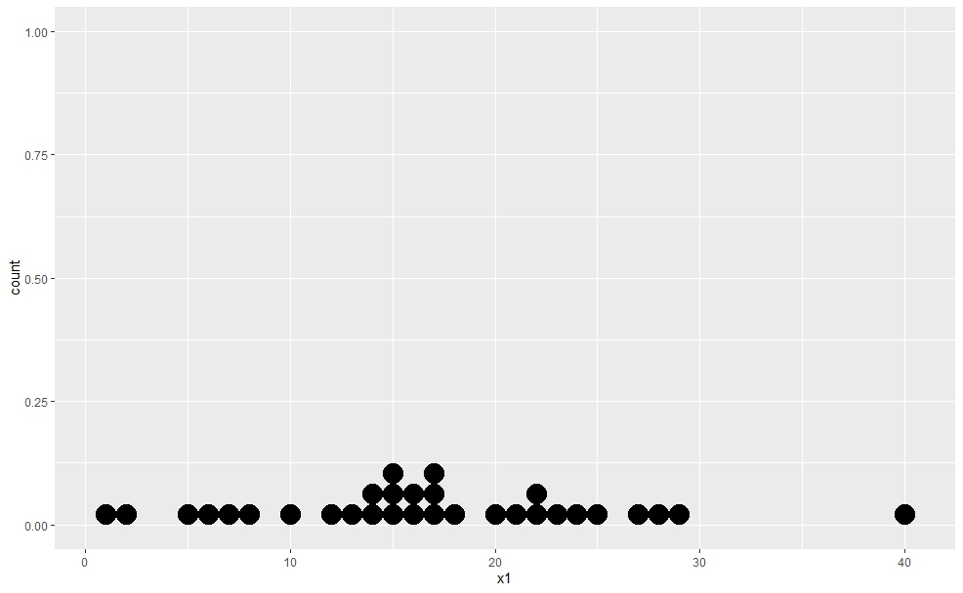
Univariate Example

Slide 45
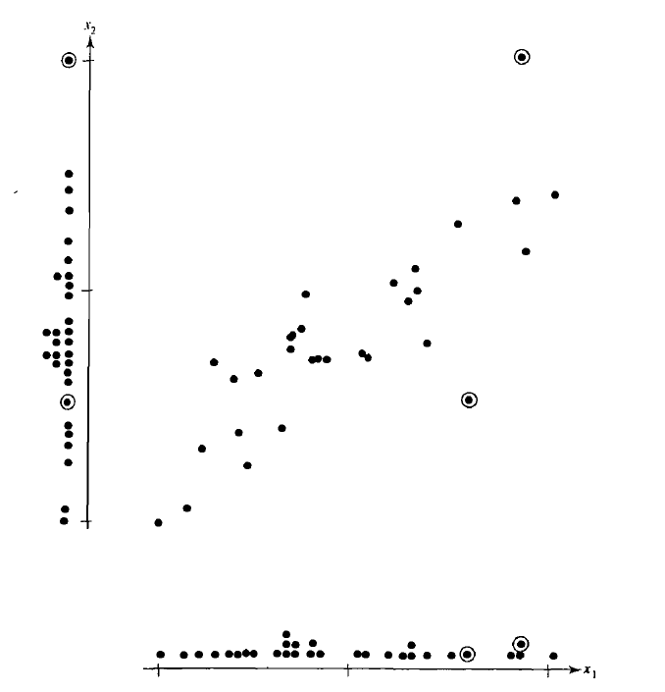
Bivariate Example

Slide 46
Bivariate Example: Marginal Dot Plot of $x_{1}$

Slide 47
Bivariate Example: Marginal Dot Plot of $x_{2}$

Slide 48
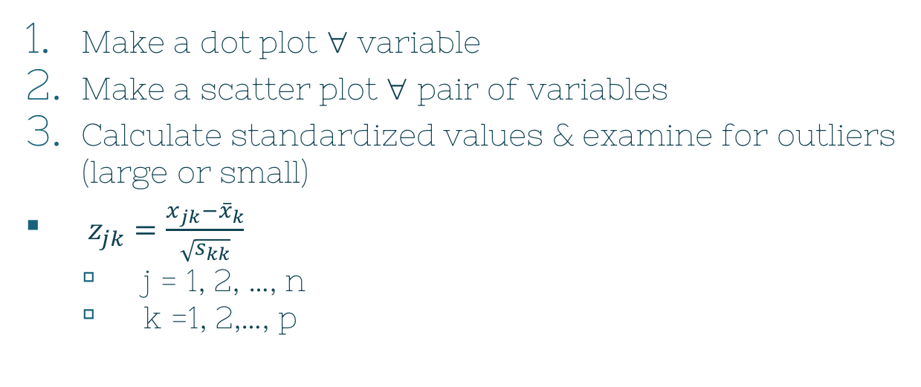
Steps for Detecting Outliers
$$π$$
Make a dot plot ∀ variable
Make a scatter plot ∀ pair of variables
Calculate standardized values & examine for outliers (large or small)
$z_{jk}=\frac{x_{jk}−{\overline{x}}_{k}}{\sqrt{s_{kk}}}$
j = 1, 2, …, n
k =1, 2,…, p

Slide 49
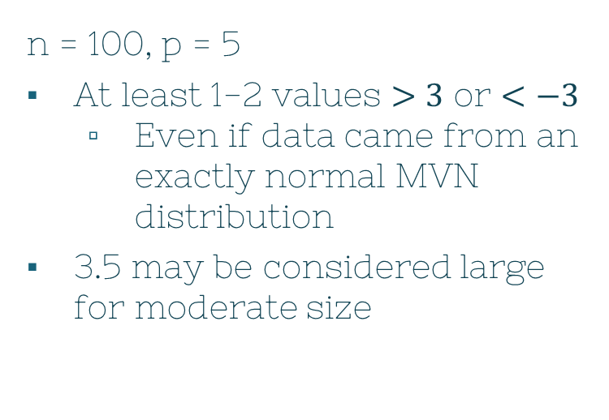
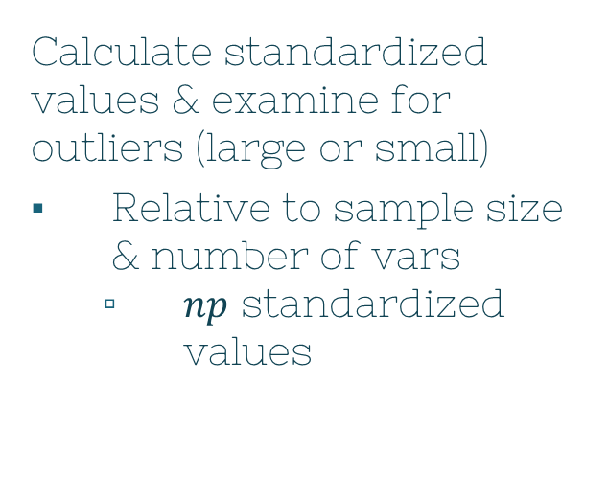
Steps for Detecting Outliers
$$π$$
Calculate standardized values & examine for outliers (large or small)
Relative to sample size & number of vars
$np$ standardized values
n = 100, p = 5
At least 1-2 values $>3$ or $<−3$
Even if data came from an exactly normal MVN distribution
3.5 may be considered large for moderate size

Slide 50

Steps for Detecting Outliers
$$π$$
4. Calculate generalized squared distance & examine for (unusually large) outliers
${\left(x_{j}−\overline{x}\right)}^{′}S^{−1}\left(x_{j}−\overline{x}\right)$
Note: In $χ_{p}^{2}$ plot, these points would be farthest from the origin

Slide 51

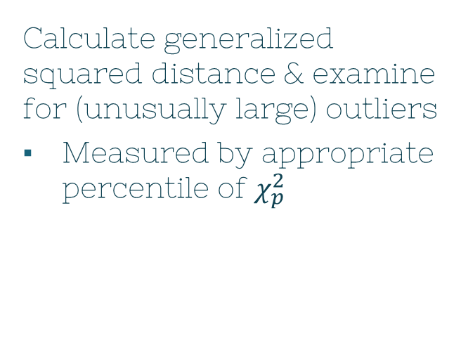
Steps for Detecting Outliers
$$π$$
Calculate generalized squared distance & examine for (unusually large) outliers
Measured by appropriate percentile of $χ_{p}^{2}$
n = 100
5 obs expected to have $d_{p}^{2}>χ_{p}^{2}(0.95)$

Slide 52
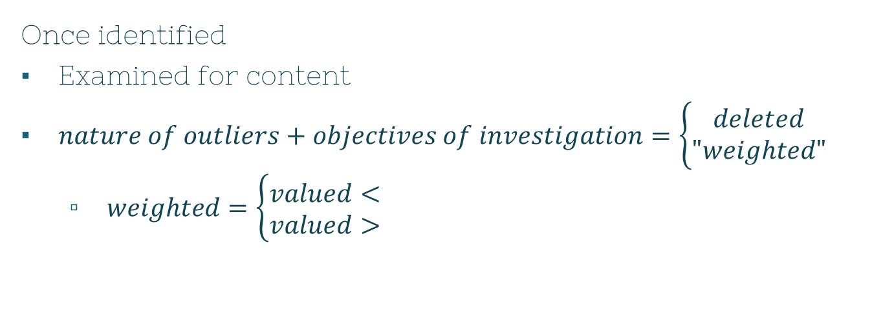
What to do with Outliers?
$$π$$
Once identified
Examined for content
$nature of outliers+objectives of investigation=\left\{\begin{aligned}deleted \\ "weighted"\end{aligned}\right.$
$weighted=\left\{\begin{aligned}valued< \\ valued>\end{aligned}\right.$

Slide 53
Transformations to Near Normality
3
Chapter 4, Section 8

Slide 54
What if normality isn’t a viable assumption? What can we do?

Slide 55

Option 1
$$π$$
Ignore the non-normal results
Pretend the data is normally distributed
Proceed with your work
Leads to wrong conclusions
X
So what do we do?

Slide 56
Option 2
$$π$$
Make the non-normal look normal!
Transformations

Slide 57
Transformations
$$π$$
Transformation
Re-expression of the data in different units
Can provide more natural expressions of studied characteristics
How to know what’s the appropriate one?
Theoretical consideration
The data themselves
both

Slide 58
Transformations: Theoretical
$$π$$
Theoretically
(whole number/integer) data can be made more normal
Taking square roots
This is similar for:
Logit transform
Proportions
Fisher’s z-transform
Correlation coefficients

Slide 59
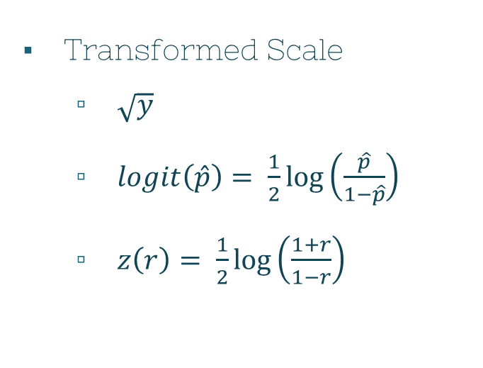

Helpful Transformations to Near Normality
$$π$$
Original Scale
Counts: y
Proportions: $\hat{p}$
Correlations: r
Transformed Scale
$\sqrt{y}$
$logit\left(\hat{p}\right)= \frac{1}{2}\log\left(\frac{\hat{p}}{1−\hat{p}}\right)$
$z\left(r\right)= \frac{1}{2}\log\left(\frac{1+r}{1−r}\right)$

Slide 60

Transformations: Data
$$π$$
In many instances
Choice of transformation to improve $≈$ to normal
Not obvious
Let the data suggest
Power transformations
Defined only for positive vars
Notes:
Not as restrictive as it seems, because a single constant can be added to each obs in the data set if some of the values are negative

Slide 61


Transformations: Data
$$π$$
Let
x = arbitrary observation
λ = indexed parameter
$x^{λ}$
When λ = …
$−1→\frac{1}{x}$
$0→lnx$
$\frac{1}{2}→\sqrt{x}$
$2→x^{2}$
$4→x^{4}$

Slide 62
Transformations: Data
$$π$$
How to select a power transformation?
Look at marginal dot diagram or histogram
Decide whether large values have to be reduced or increased
Trial & error calculations to see best improvement of mean’s symmetry
Examine final choice by Q-Q plot or other checks to see if our normal assumption is satisfactory

Slide 63

Transformations: Univariate
$$π$$
There is an analytical method to finding the best power transformation!
Box & Cox consider this slightly modified family:
$$x_{j}^{(λ)}=\left\{\begin{aligned}\frac{x^{λ}−1}{λ}, λ≠0 \\ lnx, λ=0\end{aligned}\right.$$
Continuous in λ for $x>0$

Slide 64

Transformations: Univariate
$$π$$
Box & Cox solution:
Given the obs $x_{1}, x_{2},…, x_{n}$
The choice of an appropriate λ is the one that maximizes this expression:
$$ℓ\left(λ\right)=−\frac{n}{2}ln\left[\frac{1}{n}\sum_{j−1}^{n}{{\left(x_{j}^{\left(λ\right)}−\overline{x^{\left(λ\right)}}\right)}^{2}}\right]+(λ−1)\sum_{j=1}^{n}{lnx_{j}}$$

Slide 65

Transformations: Univariate
$$π$$
$$ℓ\left(λ\right)=−\frac{n}{2}ln\left[\frac{1}{n}\sum_{j−1}^{n}{{\left(x_{j}^{\left(λ\right)}−\overline{x^{\left(λ\right)}}\right)}^{2}}\right]+(λ−1)\sum_{j=1}^{n}{lnx_{j}}$$
$\overline{x^{(λ)}}=\frac{1}{n}\sum_{j=1}^{n}{x_{n}^{(λ)}}=\frac{1}{n}\sum_{j=1}^{n}{\left(\frac{x_{j}^{λ}−1}{λ}\right)}$
Average of the transformed obs
Logarithm of normal likelihood function
After maximizing it w/ respect to the population mean and variance parameters
Notes:
Helpful to have a graph of l(lambda) vs lambda & a tabular display of the pairs to study the behavior near maximizing value lambda-hat

Slide 66

Transformations: Univariate
$$π$$
Statistician recommendation of fixing λ:
$$y_{j}^{(λ)}=\frac{x_{j}^{λ}−1}{λ{\left[{\left(\prod_{i=1}^{n}{x_{i}}\right)}^{\frac{1}{n}}\right]}^{λ−1}}, j=1,…,n$$
Calculate $S$
Minimum of variance occurs at the same λ that maximizes $ℓ(λ)$

Slide 67

Comment
Transformation obtained by maximizing $ℓ(λ)$ usually improves the $≈$ to normal
No guarantee that even best chosen λ will produce a transformed dataset that adequately conforms to $N(μ,σ^{2})$
Always check if the data possibly violates the normality assumption
For any transformation

Slide 68

Transformations: Multivariate
$$π$$
Power transformation
Must be selected ∀ variables
Similar process with the univariate, but more complex
Notation
$λ_{1}, λ_{2},…,λ_{p}$
Power transformation for p measured characteristics

Slide 69

Transformations: Multivariate
$$π$$
$$ℓ_{k}\left(λ\right)=−\frac{n}{2}ln\left[\frac{1}{n}\sum_{j−1}^{n}{{\left(x_{jk}^{\left(λ_{k}\right)}−\overline{x_{k}^{(λ_{k})}}\right)}^{2}}\right]+(λ_{k}−1)\sum_{j=1}^{n}{lnx_{jk}}$$
Procedure
Making each marginal distribution $≈$ normal
$x_{1k}, x_{2k},…,x_{nk}$
n obs on kth var, $k=1,2,…,p$
$\overline{x_{k}^{(λ_{k})}}=$ average of transformed vars

Slide 70


Transformations: Multivariate
$$π$$
$$x_{j}^{(\hat{λ})}=\left[\begin{matrix}\begin{aligned}\frac{x_{j1}^{\hat{λ_{1}}}−1}{\hat{λ_{1}}} \\ \frac{x_{j2}^{\hat{λ_{2}}}−1}{\hat{λ_{2}}}\end{aligned} \\ \begin{aligned}. \\ . \\ .\end{aligned} \\ \frac{x_{jp}^{\hat{λ_{p}}}−1}{\hat{λ_{p}}}\end{matrix}\right]$$
Jth transformed MV obs
$\hat{λ_{1}},\hat{λ_{2}},…,\hat{λ_{p}}$
values that individually maximize $ℓ_{k}(λ)$
Procedure $≡$ making each marginal distribution $≈$ normal
Sufficient to ensure the joint distribution is normal in practical applications

Slide 71


Transformations: Multivariate
$$π$$
$x_{j}^{(\hat{λ})}$ can also be used to iterate towards
$λ^{′}=\left[λ_{1},λ_{2},…,λ_{p}\right]$
Collectively maximizes the function below
$$ℓ\left(λ_{1},λ_{2},…,λ_{p}\right)=−\frac{n}{2}\ln\left|S\left(λ\right)\right|+\left(λ_{1}−1\right)\sum_{j=1}^{n}{lnx_{j1}}+…+\left(λ_{p}−1\right)\sum_{j=1}^{n}{lnx_{jp}}$$
$S\left(λ\right)=$ sample covariance matrix computed from $x_{j}^{(λ)}$
$j=1,2,…,n$

Slide 72


Transformations: Multivariate
$$π$$
$ℓ(λ_{1},λ_{2},…,λ_{p}$)
Maximize a MV likelihood
$μ$
$Σ$
$λ$
Difficult to select appropriate transformations
Unlikely to yield remarkably better results
$$ℓ_{k}(λ)$$
Maximize kth univariate likelihood
${μ }_{k}$
$σ_{kk}$
$λ_{k}$
Easier to select appropriate transformations

Slide 73

What If…
$$π$$
General Transformation:
$$x^{(λ)}=\left\{\begin{aligned}\frac{{(x+1)}^{λ}−1}{λ};x≥0,λ≠0 \\ \ln\left(x+1\right);x≥0, λ=0 \\ −\frac{{(−x+1)}^{2−λ}−1}{2−λ};x<0,λ≠2 \\ −ln\left(−x+1\right);x<0, λ=2\end{aligned}\right.$$
Data
Large negative values
Single long tail

Slide 74
In Section 4.8, the authors explain that even if the assumption of normality is rejected, we still have the option of transforming the data to make it more "normal-looking." "Normal-theory analyses can then be carried out with the suitably transformed data." They suggest that "power transformations" are often a useful tool for this. Are there situations in practice where a power transformation is a bad idea (leads to misleading results), even if it makes normal-theory analyses possible? Or should we not worry about this?

Slide 75
Transformation Bad?
$$π$$
Should we worry about transformation in general?
In real life
Numerous data don’t hold normality assumption
Transformation
Easier to apply procedures

Slide 76
Transformation Bad?
$$π$$
Transformation errors can occur if:
Transformation tool/framework can’t correctly apply the desired procedures & rules to extracted info from unstructured data source
Audio file containing speech/music/noise
Failed text conversion
Generate incomplete/incorrect output
Data source is ambiguous, complex, or context-dependent

Slide 77
Transformation Bad?
$$π$$
So, transform at your own risk!
Highly dependent of what you’re investigating
Use a sample to test if transformation is necessary

Slide 78
References
Geometry of MVN Distribution
https://online.stat.psu.edu/stat505/lesson/4/4.6
Shapiro-Wilk Test
https://builtin.com/data-science/shapiro-wilk-test
Transformation Errors
https://www.linkedin.com/advice/3/what-most-common-data-transformation-errors-when-4jche
Understanding Q-Q plots
https://library.virginia.edu/data/articles/understanding-q-q-plots#:~:text=The%20QQ%20plot%2C%20or%20quantile,as%20a%20normal%20or%20exponential
Visualizing the Multivariate Normal
http://www2.stat.duke.edu/~rcs46/lectures_2015/02-multivar2/02-multivar2.pdf

Slide 79
~Fin~
Any lingering questions?

